Slide 1



On the Road to
MIDDLE SCHOOL
CLASS OF
‘29
Mission Possible: Graduation and Beyond
Supports BRIDGE Law Advisement
Transitioning from Fifth Grade to Sixth Grade

Slide 2
The trip begins...
…on the road to a new and exciting destination – Middle School!
Like most people who start a new journey, you probably have a lot of questions
Think of this presentation as your road map or GPS – we’re here to help you “find your way”, not only to middle school, but through high school and beyond!

Slide 3
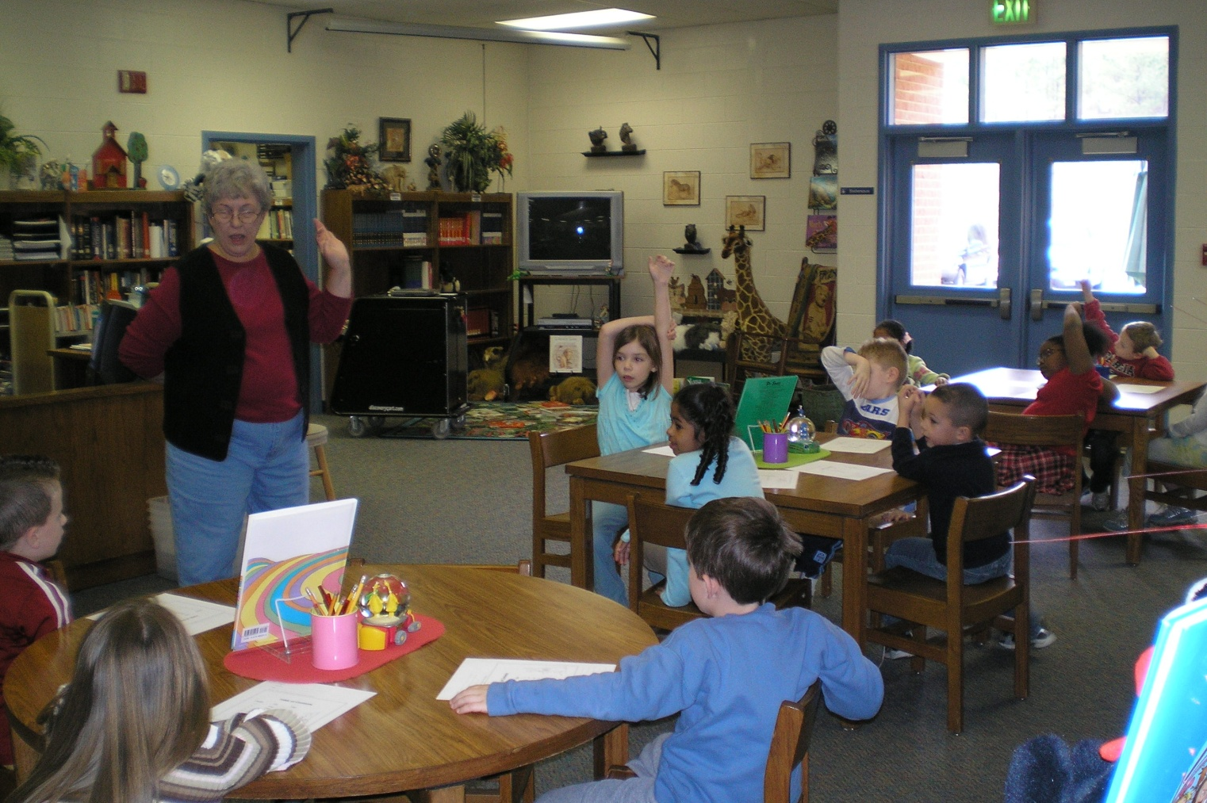
In Elementary School...
Photo – Northside Elementary
...most students have one
teacher in one classroom.

Slide 4
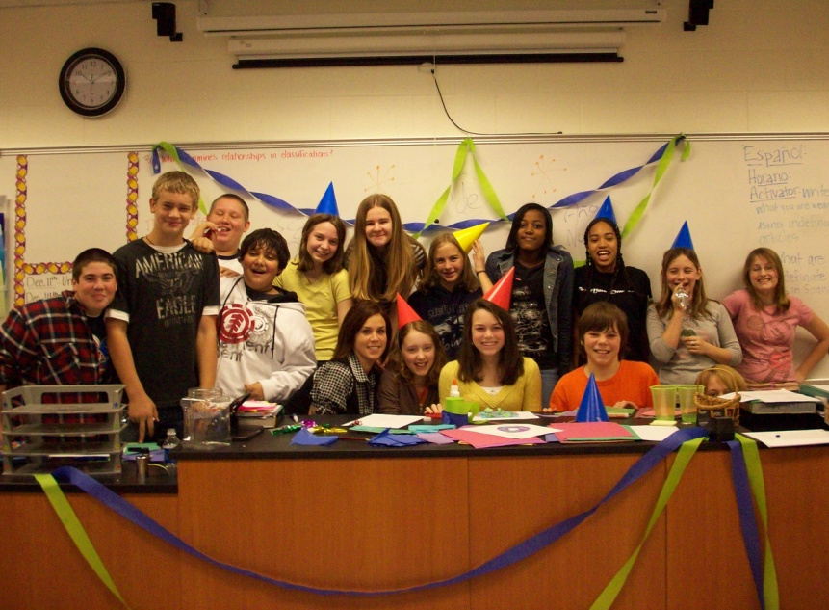
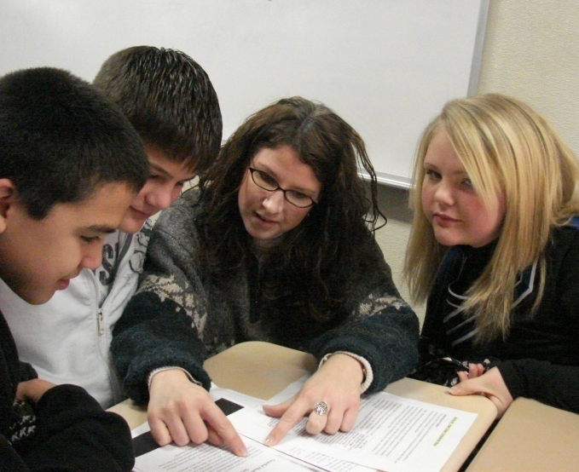
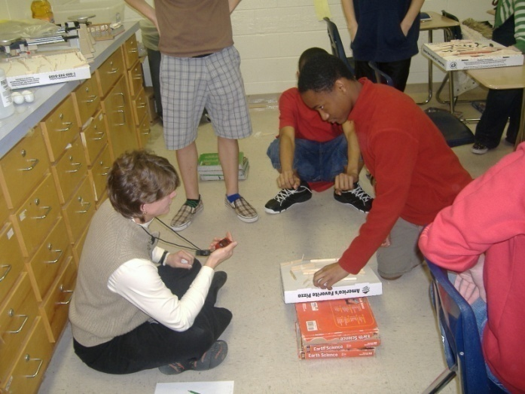
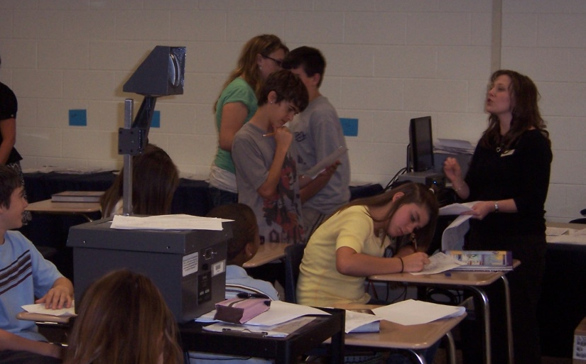
In Middle School...
...most students have several teachers
who meet in different classrooms.

Slide 5
A Typical Schedule
Homeroom
Academic Enrichment
Math class
Language Arts class
Science class
Social Studies class
Two Connections classes (electives)

Slide 6
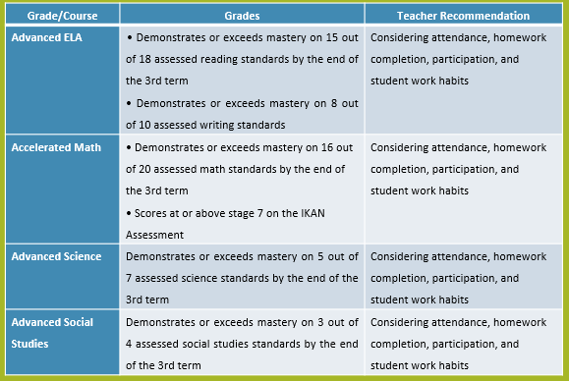
For Some Students There May be Advanced Courses
in English, Mathematics, Science &/or Social Studies

Slide 7
Students Who Take Advanced Middle School Courses in English and Math
Please thoroughly review MS 101 guide information about advanced and high school courses taken during middle school.
Honors 9th Grade English, Honors Physical Science, and Honors GSE Algebra I are high school courses that are offered in the 8th grade school year.
Some students take Spanish I in 7th and 8th grade.
It is important to do well in 6th and 7th grade courses and meet all requirements, if a student wants to do one or more of the above courses.

Slide 8
SB289 Online Courses
Students who are interested in taking an online middle school course must have the parent apply online during April/May/June on the district website for the following school year.
Online course opportunities are sometimes limited at both the middle and high school levels.
Counselors advise both students and parents regarding online course opportunities.
Please refer to the MS 101 guide and or the district Career Planner for further information.

Slide 9
Being on a Team
Each student in a middle school is assigned to a team. There are usually three teams at each grade level, this varies depending on the size of the middle school. The team consists of a group of students and teachers who work together throughout the year.
Typically, teams consist of three to four teachers. The team concept allows students to have a close student-teacher relationship while still having the opportunity to work.
In middle school, you will meet lots of new people and will have different students in each classroom.

Slide 10
As a matter of fact...
Allgood
Dallas
We're All Tigers Now!
Northside
Poole
HJMS
...you'll be meeting students
from several different schools!

Slide 11
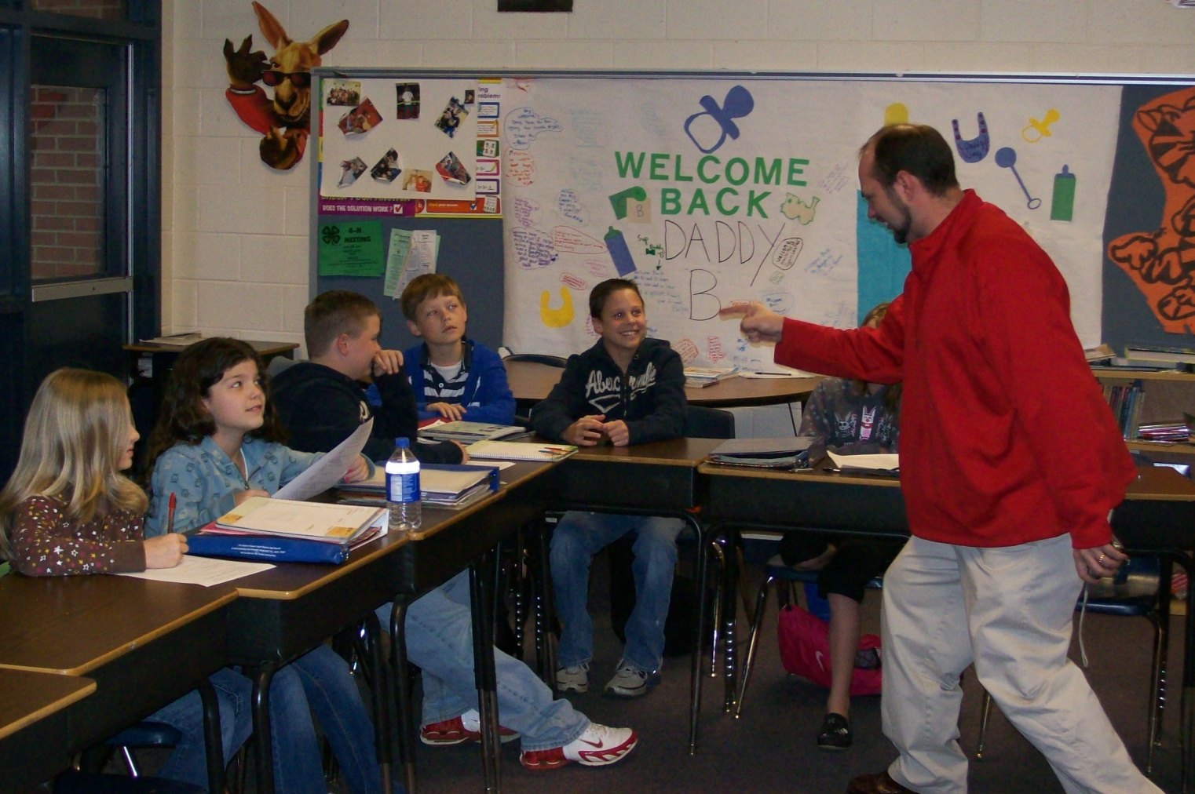
In Elementary School...
Photo – Panter Elementary
...you've gotten used to the expectations and
getting reminders from your teachers.

Slide 12
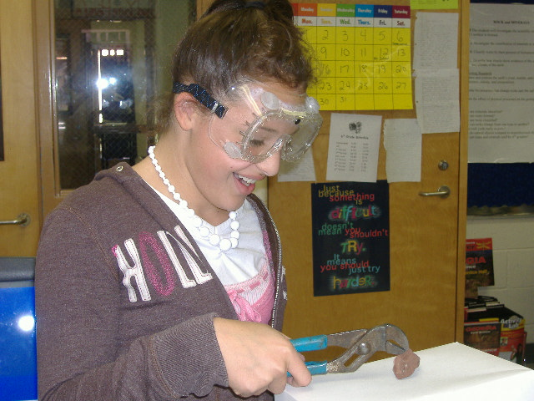
In Middle School...
...you'll find that expectations are different,
and students are given more responsibility.

Slide 13
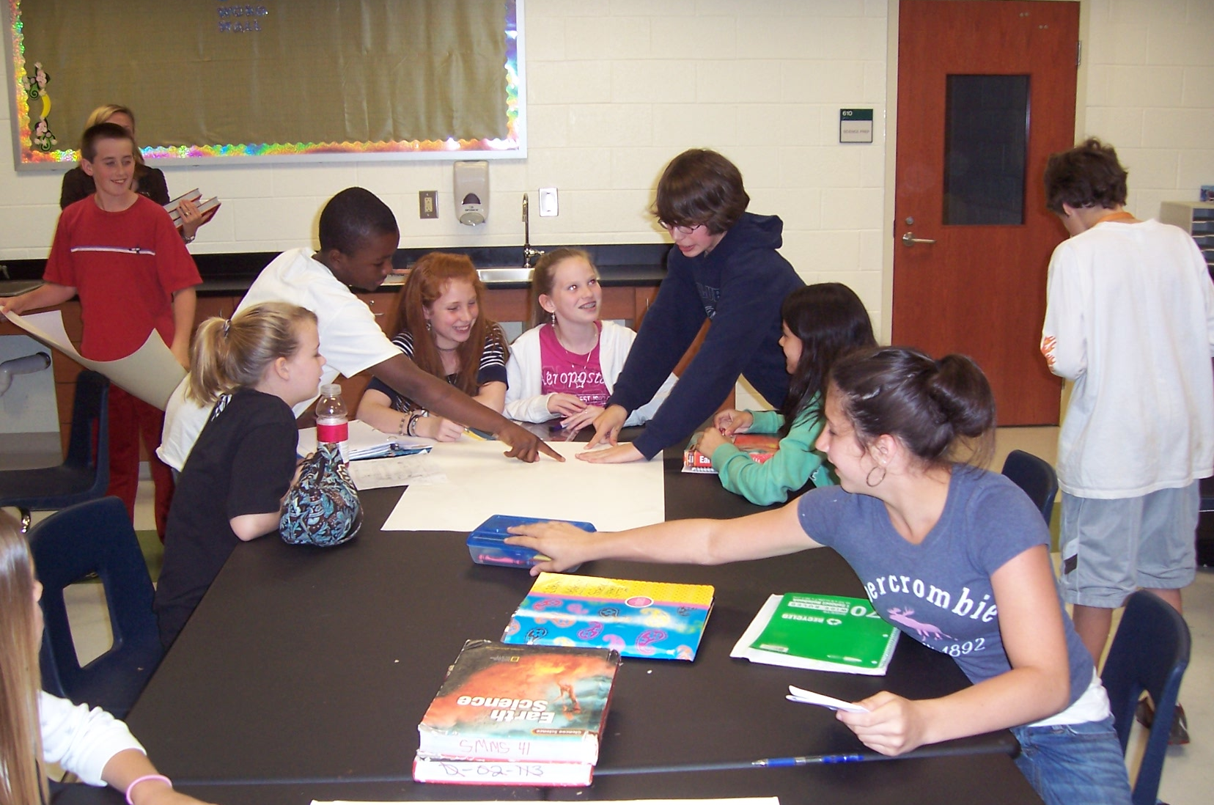
In Middle School...
...you'll receive more homework, and
you'll have to mature as a student.

Slide 14
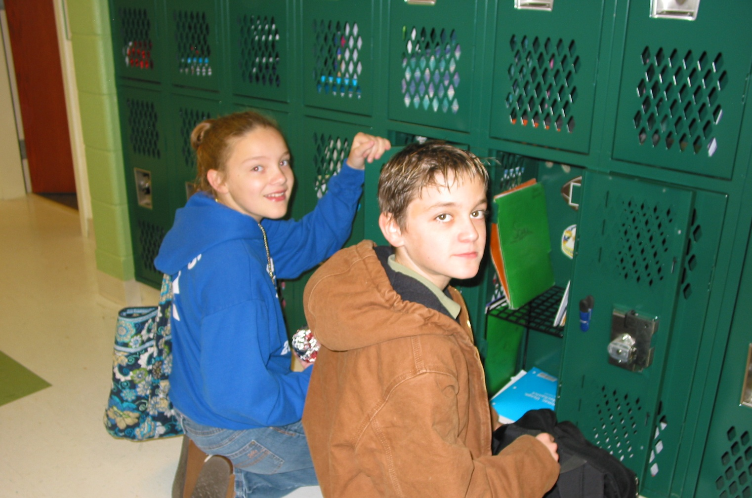
In Middle School...
...your belongings will be
stored in your locker.

Slide 15
LOCKER
LANE
You will get a locker to keep and organize your books and materials.
You’ll have to learn to keep it neat!
You also will need to use your time wisely during locker breaks.

Slide 16
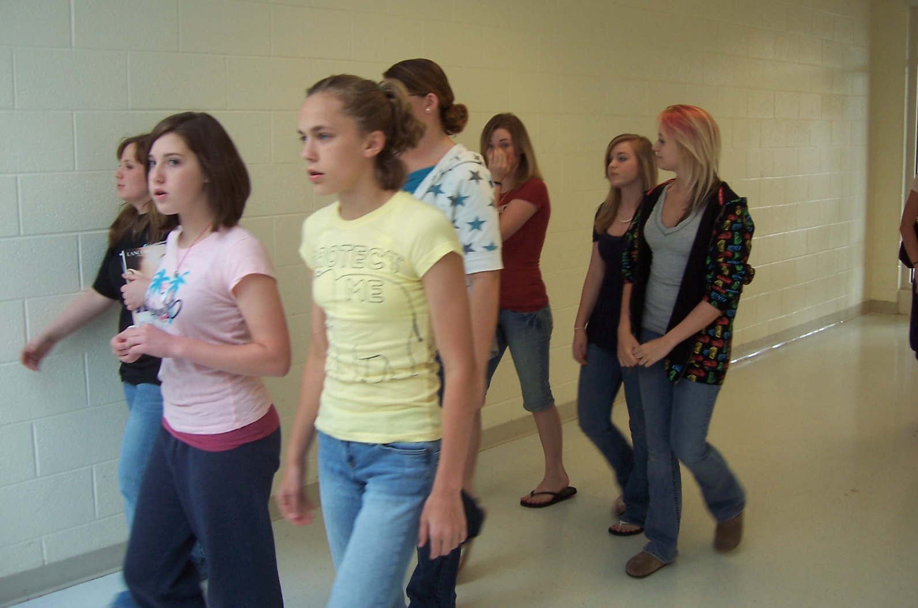
In Middle School...
...you can walk to your
next class on your own.

Slide 17
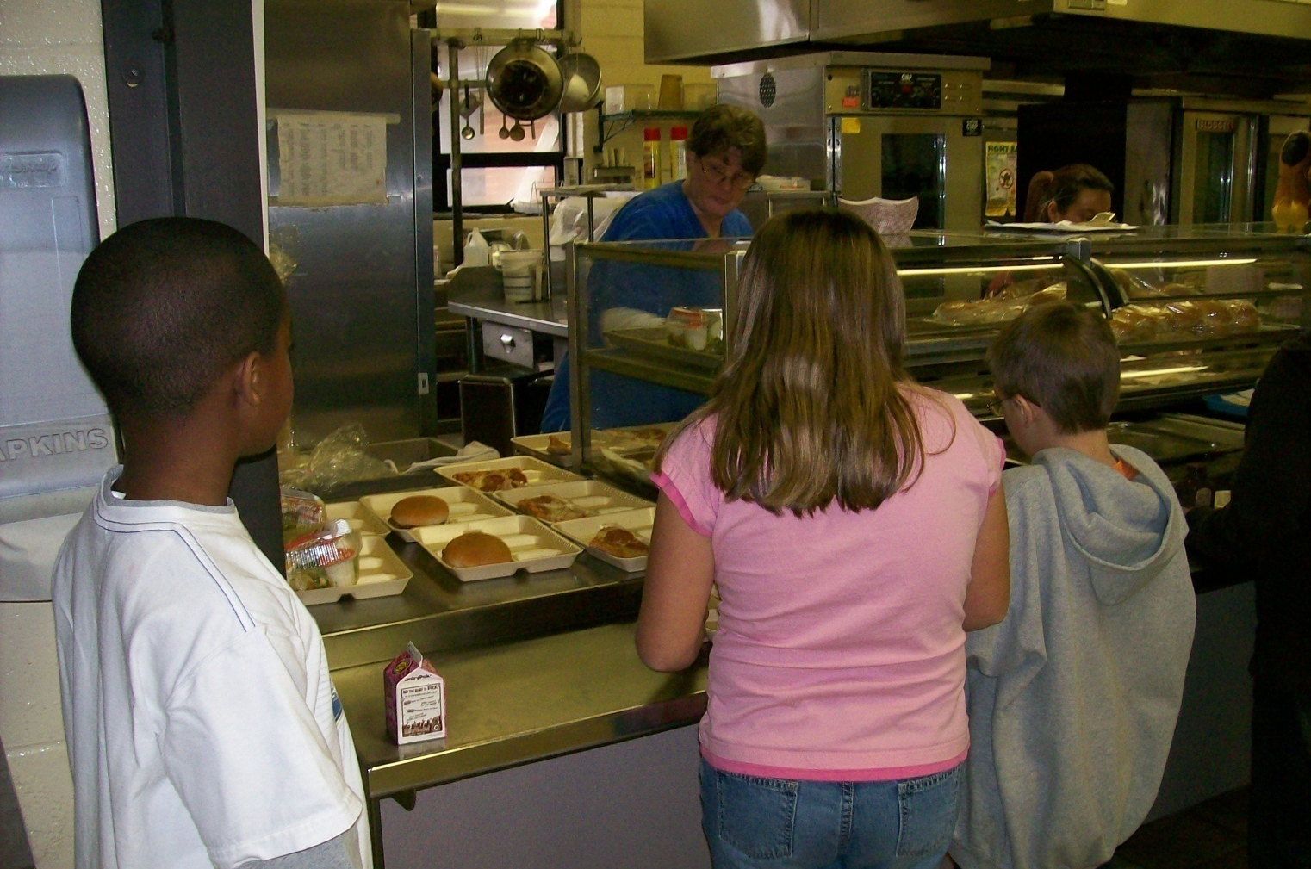
In Elementary School...
Photo – Hiram Elementary
... there are less choices in the cafeteria.

Slide 18
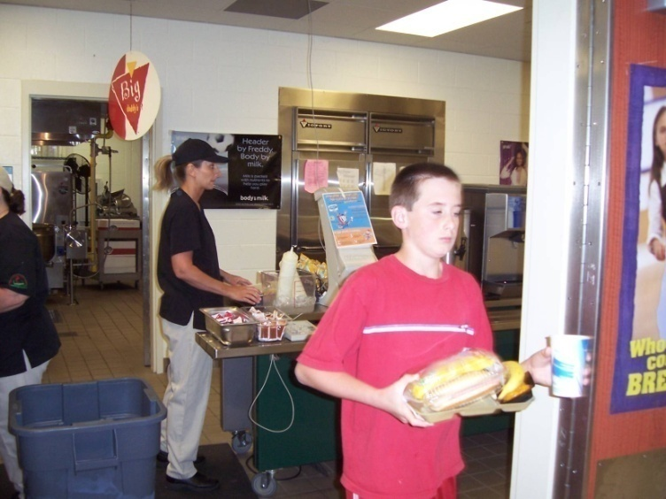
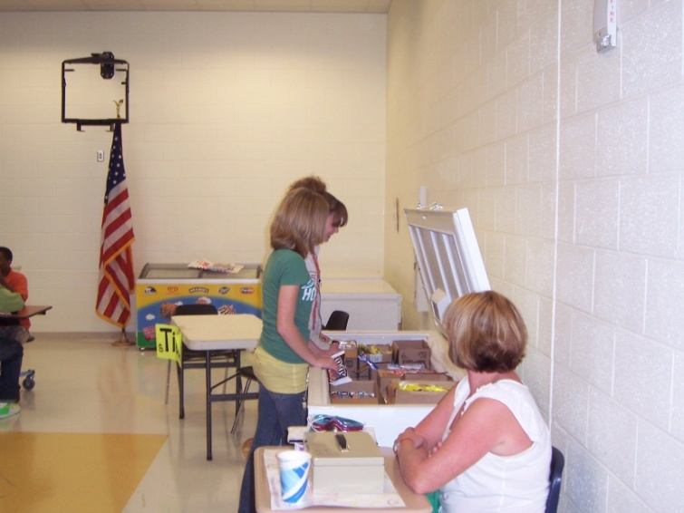
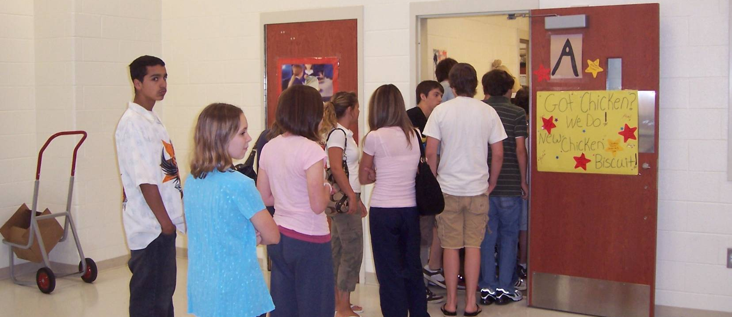
In Middle School...
Photo – McClure Middle
...you will have more choices
of food in the cafeteria.

Slide 19



In the Cafeteria...
You’ll go to lunch with one of your academic teachers. Each teacher will have assigned tables for their class, but you’ll choose where you sit at those tables!
LUNCH – THIS EXIT
HOT MEAL
PIZZA
SALAD BAR

Slide 20
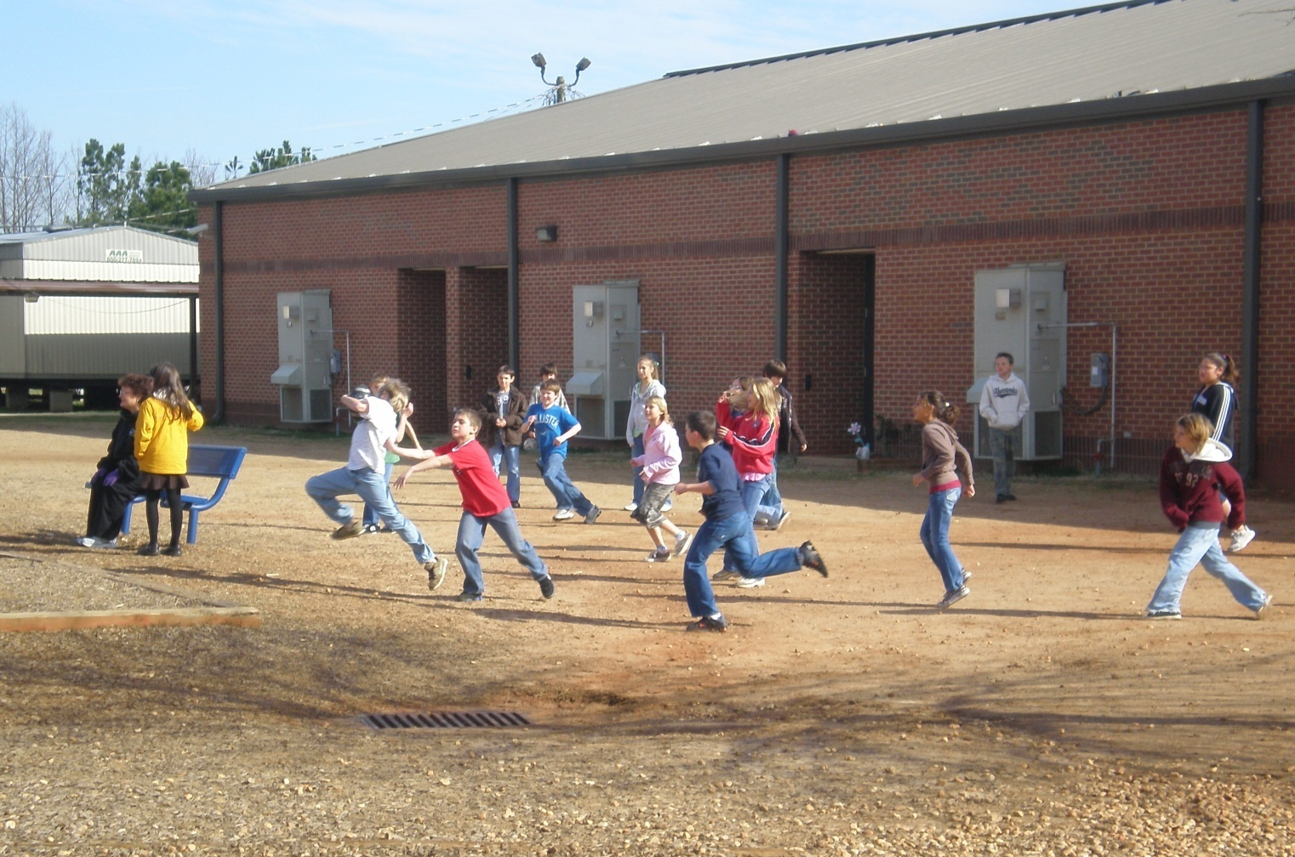
In Elementary School...
Photo – Shelton Elementary
...you've been used to
having a daily recess.

Slide 21
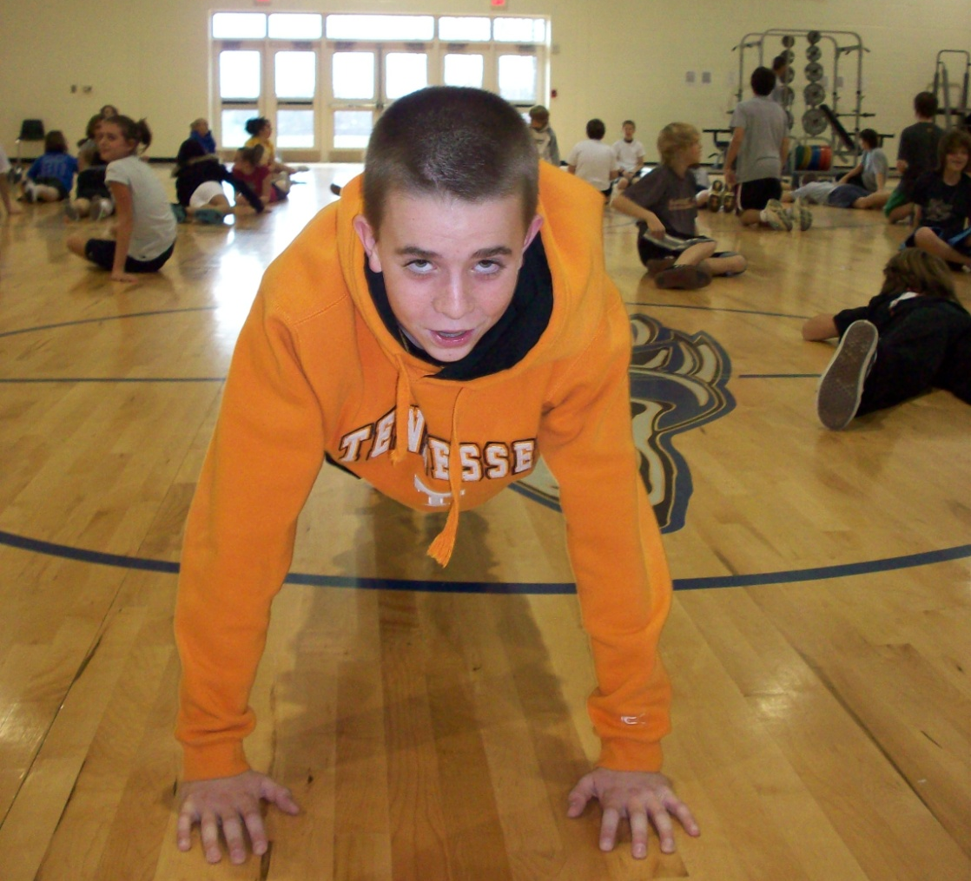
In Middle School...
...you will no longer have a daily
recess (but you may have PE).

Slide 22
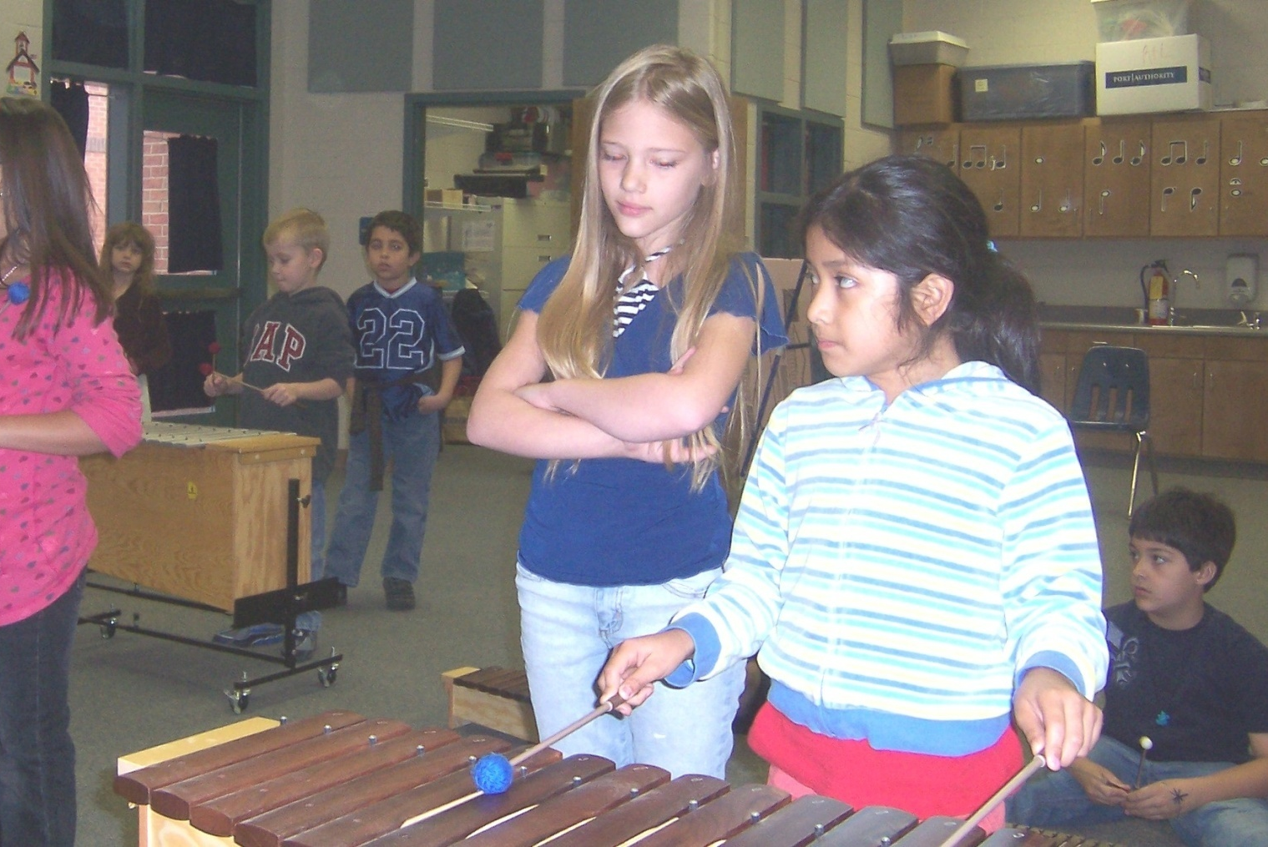
In Elementary School...
Photo – Roberts Elementary
...you have a weekly rotation of specials, including
PE, art, music, computer lab, and classroom guidance.

Slide 23
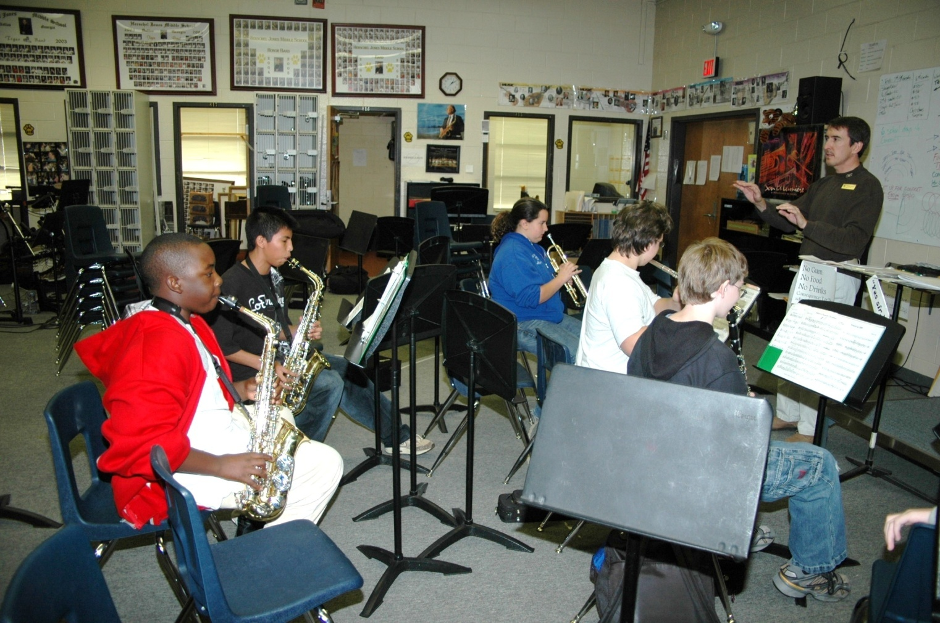
In Middle School...
Photo – Herschel Jones Middle
...you will have daily Connections
classes that are part of your schedule.

Slide 24
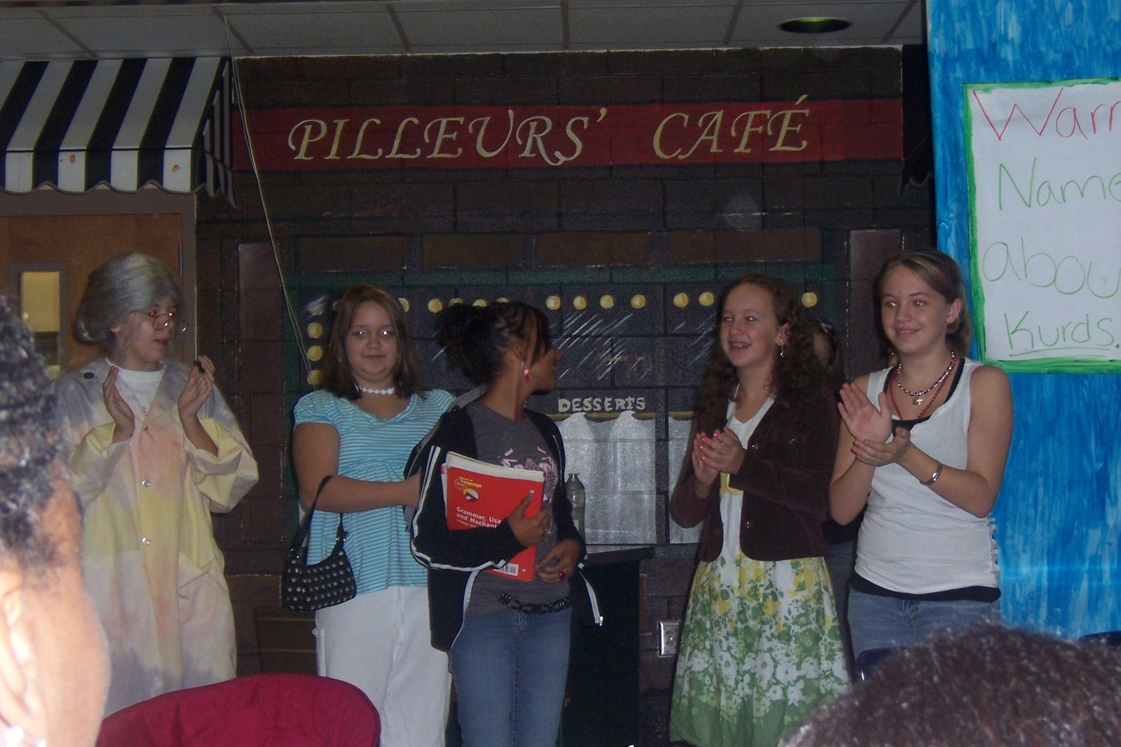
In Middle School...
...you have
several choices of
school activities and clubs.

Slide 25
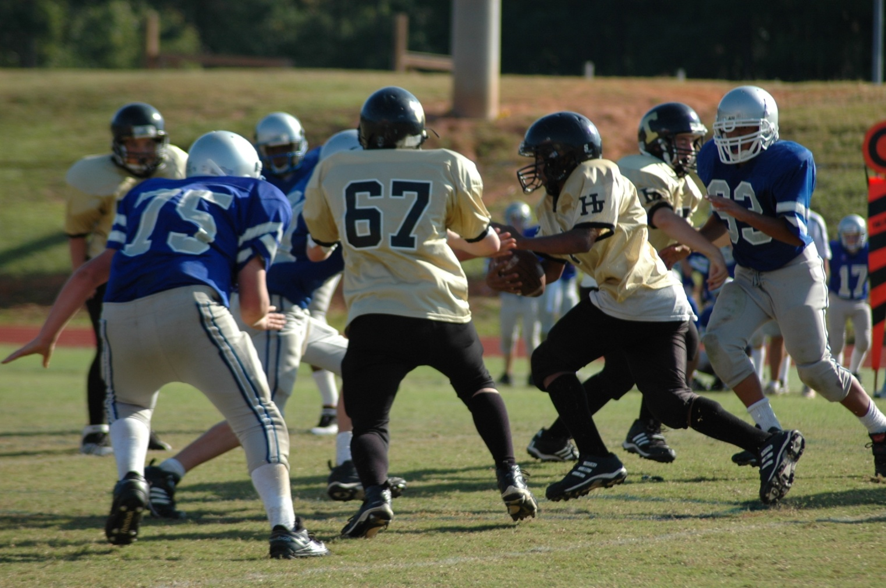
In Middle School...
Photo – HJMS vs. SPMS
There are no official middle school sports, but many students will
participate in club sports outside of the school that are feeder programs
for the high schools.

Slide 26
Testing - In middle school there is still testing.
Georgia Milestones- All grades

Slide 27
BRIDGE Law- Mandated Advisement in Middle School
In May of 2010, the BRIDGE Bill was signed into law, and it has been updated every few years since then. Thus, there are mandated advisement steps that must be taken with middle school students. School Counselors facilitate these opportunities.

Slide 28
In Elementary School...
BRIDGE (Building Resourceful Individuals Developing Georgia’s Economy) Law for Elementary Students
Career Cluster Awareness Lessons for 5th grade students 11 of the 17 Career Clusters have been taught

Slide 29
BRIDGE Law - Mandated Advisement in Middle School
The following BRIDGE Bill advisement tasks are required to be completed in middle school in the student’s GCIS JR portfolio:
  Grade 6
    Career Cluster Survey must be completed. ( You Science)
  Grade 7
    Reality Inventory must be completed.
    3 Career Concentrations/Clusters must be explored.
    You Science Career Inventory Snapshot is completed.
  Grade 8
    3 Careers and Occupational Information must be saved on these careers in the student’s portfolio.
    Individual Graduation Plan is updated on the Graduation Plan/Program of Study from the BRIDGE Advisement Plan
    IGP is updated within Infinite Campus (District Student Information System)
    Dual Enrollment Information is Provided
    You Science Career Inventory Snapshot is completed.

Slide 30
Some Helpful People
You’ll find that we have a lot of helpful people who work at the middle school.
In addition to our teachers, you’ll find the following special people…

Slide 31
Administrators
The administration usually consists of a principal, assistant principals, and/or administrative assistants. They have many responsibilities including the operation of the school.
Administrators are there every step of the way to support students in the valuable learning process. These school officials work to ensure the success and safety of the learning community. They are valuable assets to the school and community!
Principal, Asst. Principal, and Asst. Principal

Slide 32
School Counselors
School counselors support students in three life areas-academic, career, and personal/social. The focus of the counseling program facilitates student learning and academic success.
Middle school counselors are available to work with students, parents, and teachers through guidance, counseling, consultation services, and referral delivery systems.
School counselors support All BRIDGE Law Advisement tasks with students and support students to be College and Career Ready.

Slide 33
School Resource Officer
The School Resource Officer is a uniformed officer whose assignment is to help ensure that the students have an atmosphere that is conducive to a good education, eliminating distractions that may hamper students in their ability to learn.
SRO Name

Slide 34

Required Immunizations
The State of Georgia requires that all students entering public school have a completed certificate of immunization on file with the school.
At the time students are transitioning to middle school, there may be several immunization updates that he or she will need. An up-to-date immunization form is due prior to the first day of school.
Please have your parent check with your healthcare provider to see if you need any additional immunizations.
The state sends an auditor to check 6th grade records each fall. They will make a list of individual students who need additional immunizations.
Failure to provide documentation of up-to-date
immunizations can cause you to be withdrawn
from school.

Slide 35

Don’t worry!
You’ll be fine!
DO NOT
WORRY

Slide 36

Because we’re going to have lots of people to help you…
BUCKLE UP
FOR FUN

Slide 37
Remember to Review the Middle School 101 Guide
& Continue On the Road to Success!
SUCCESS
RD

Slide 38
Mission Possible: Graduation and Beyond
Middle School Welcomes the Class of 2029
QUESTIONS?

